Slide 1
Unit No. IV
Advanced SQL
Prepared by: Mr. A. R. Pradnyavant

Slide 2
Contents
PL SQL- A Basic introduction
Functions and Procedure
Packages
Synonyms
Database Links
Embedded SQL and Dynamic SQL.
Prepared by: Mr. A. R. Pradnyavant

Slide 3
PL SQL- A Basic introduction
What is PL/SQL?
PL/SQL is Oracle’s procedural language extension to SQL.
PL/SQL allows you to mix SQL statements with procedural statements like IF statement, Looping structures etc.
PL/SQL is the superset of SQL.
It uses SQL for data retrieval and manipulation and uses its own statements for data processing.
PL/SQL program units are generally categorized as follows:
Anonymous blocks
Stored procedures
Prepared by: Mr. A. R. Pradnyavant

Slide 4
Anonymous block
This is a PL/SQL block that appears within your application.
In many applications PL/SQL blocks can appear where SQL statements can appear. Such blocks are called as Anonymous blocks.
Stored Procedure
This is a PL/SQL block that is stored in the database with a name.
Application programs can execute these procedures using the name.
Oracle also allows you to create functions, which are same as procedures but return a value
And packages, which are a collection of procedures and functions.
Prepared by: Mr. A. R. Pradnyavant

Slide 5
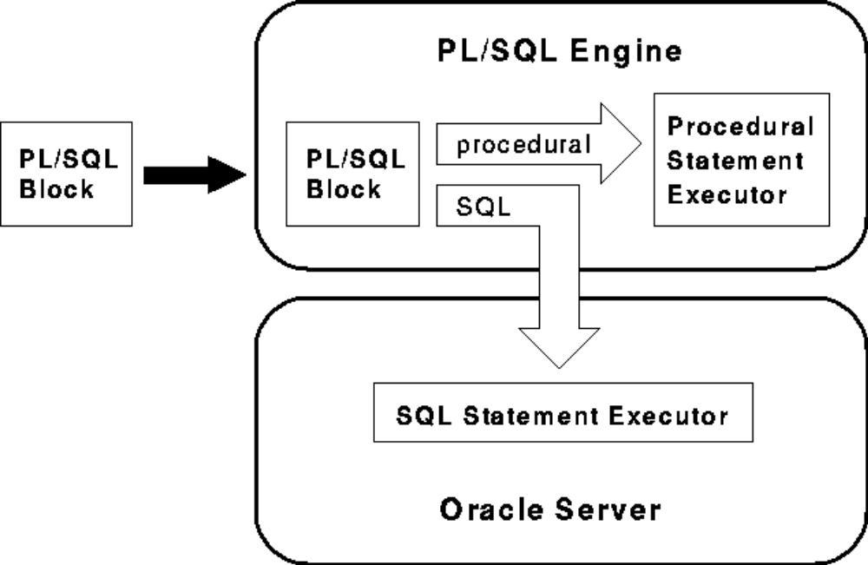
PL/SQL Engine
Prepared by: Mr. A. R. Pradnyavant

Slide 6
PL/SQL Engine
Every PL/SQL block is first executed by PL/SQL engine.
This is the engine that compiles and executes PL/SQL blocks.
PL/SQL engine is available in Oracle Server and certain Oracle tools such as Oracle Forms and Oracle Reports.
PL/SQL engine executes all procedural statements of a PL/SQL of the block, but sends SQL command to SQL statements executor in the Oracle RDBMS.
That means PL/SQL separates SQL commands from PL/SQL commands and executes PL/SQL commands using Procedural statement executor, which is a part of PL/SQL engine
Prepared by: Mr. A. R. Pradnyavant

Slide 7
Features of PL/SQL
Block structure
PL/SQL is a block-structured language. Each program of PL/SQL is written as a block. Blocks can also be nested. Each block is meant for a particular task.
Variables and constants
PL/SQL allows you to declare variables and constants. Variables are used to store values temporarily.
Control structures
PL/SQL allows control structures like IF statement, FOR loop, WHILE loop to be used in the block. Control structures are most important extension to SQL in PL/SQL.
Exception handling
PL/SQL allows errors, called as exceptions, to be detected and handled.
Prepared by: Mr. A. R. Pradnyavant

Slide 8
Features of PL/SQL
Modularity
PL/SQL allows process to be divided into different modules. Subprograms called as procedures and functions can be defined and invoked using the name.
Cursors
A cursor is a private SQL area used to execute SQL statements and store processing information.
PL/SQL implicitly uses cursors for all DML commands and SELECT command that returns only one row.
Built-in functions
Most of the SQL functions that we have seen so far in SQL are available in PL/SQL. These functions can be used to manipulate variables of PL/SQL.
Prepared by: Mr. A. R. Pradnyavant

Slide 9
Advantages Of PL/SQL
Support for SQL
PL/SQL allows you to use SQL commands, function and operators.
The process of creating SQL statements on the fly is called as Dynamic SQL.
This is different from writing SQL commands at the time of writing the program, which is called as Static SQL.
Applications written in PL/SQL are fully portable.
PL/SQL provides high security level.
PL/SQL provides access to predefined SQL packages.
PL/SQL provides support for Object-Oriented Programming.
PL/SQL provides support for developing Web Applications and Server Pages.
Prepared by: Mr. A. R. Pradnyavant

Slide 10
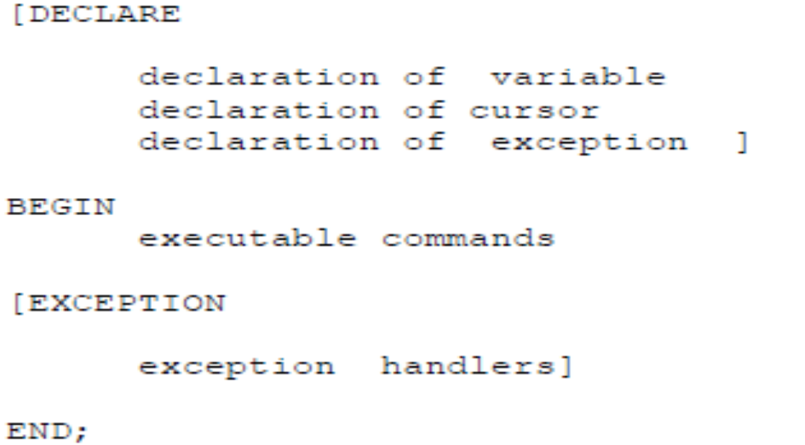
PL/SQL block
PL/SQL programs are written as blocks. Block allows you to group logically related statements and declarations.
PL/SQL block is consisting of the following three parts:
Declarative part
Executable part
Exception-handling part
The following is the syntax of PL/SQL block.
Prepared by: Mr. A. R. Pradnyavant

Slide 11
PL/SQL block
Declarations
This is the area of the block where variables, cursors etc are declared. All variables used in the block are to be declared in declarative part.
Executable Commands
Is the area where we write SQL and PL/SQL commands that are to be executed. This is the only mandatory part of the entire block.
Exception-handling
This section starts with the keyword EXCEPTION. This optional section contains exception(s) that handle errors in the program.
Prepared by: Mr. A. R. Pradnyavant

Slide 12
'Hello World' Example
DECLARE
message varchar2(20):= 'Hello, World!';
BEGIN
dbms_output.put_line(message);
END;
/
OUTPUT:
Hello World
PL/SQL procedure successfully completed.
Prepared by: Mr. A. R. Pradnyavant

Slide 13
The PL/SQL Identifiers
PL/SQL identifiers are constants, variables, exceptions, procedures, cursors, and reserved words.
The identifiers consist of a letter optionally followed by more letters, numerals, dollar signs, underscores, and number signs and should not exceed 30 characters.
By default, identifiers are not case-sensitive. So you can use integer or INTEGER to represent a numeric value.
Prepared by: Mr. A. R. Pradnyavant

Slide 14
Delimiter | Description
+, -, *, / | Addition, subtraction/negation, multiplication, division
% | Attribute indicator
' | Character string delimiter
. | Component selector
(,) | Expression or list delimiter
: | Host variable indicator
, | Item separator
" | Quoted identifier delimiter
= | Relational operator
@ | Remote access indicator
; | Statement terminator
:= | Assignment operator
=> | Association operator
|| | Concatenation operator
** | Exponentiation operator
<<, >> | Label delimiter (begin and end)
/*, */ | Multi-line comment delimiter (begin and end)
-- | Single-line comment indicator
.. | Range operator
<, >, <=, >= | Relational operators
<>, '=, ~=, ^= | Different versions of NOT EQUAL
The PL/SQL
Delimiters
Prepared by: Mr. P. B. More

Slide 15
The PL/SQL Comments
DECLARE
-- variable declaration
message varchar2(20):= 'Hello, World!';
BEGIN
/*
* PL/SQL executable statement(s)
*/
dbms_output.put_line(message);
END;
/
Prepared by: Mr. A. R. Pradnyavant

Slide 16
PL/SQL Datatypes
PL/SQL provides a variety of predefined datatypes, which can be divided into four categories:
Scalar Represents a single value.
Composite Is a collection of components
Reference Is a pointer that points to another item.
LOB Holds a lob locator.
The following are the datatypes in various categories
Categories | Types
Scalar | NUMBER, CHAR, VARCHAR2, DATE, BOOLEAN
Composite | RECORD, TABLE and VARRAY.
Reference | REF CURSOR, REF Object_type
LOB | BFILE, BLOB, CLOB, and NCLOB
Prepared by: Mr. A. R. Pradnyavant

Slide 17
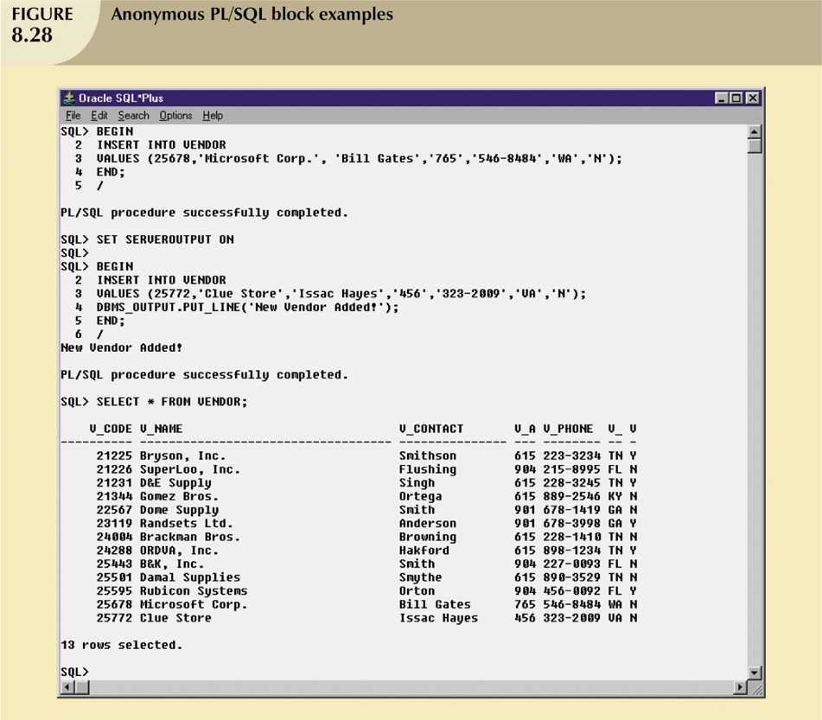

Prepared by: Mr. A. R. Pradnyavant

Slide 18
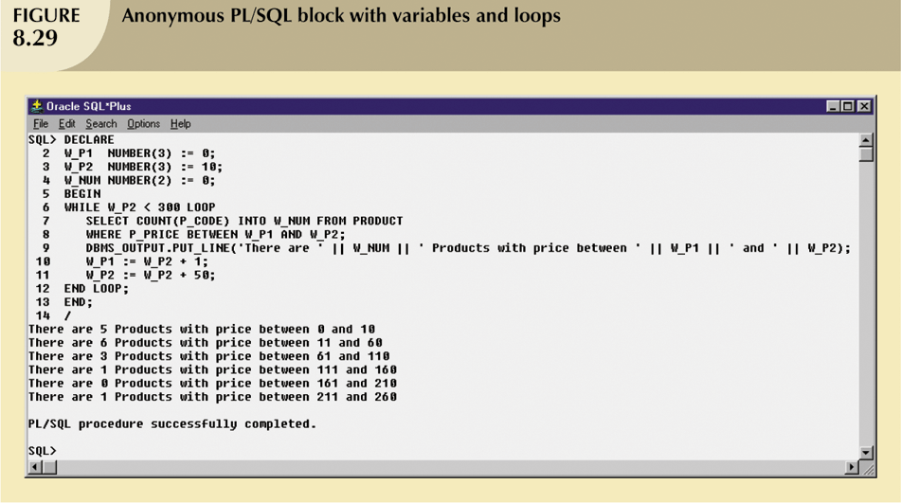
Prepared by: Mr. A. R. Pradnyavant

Slide 19
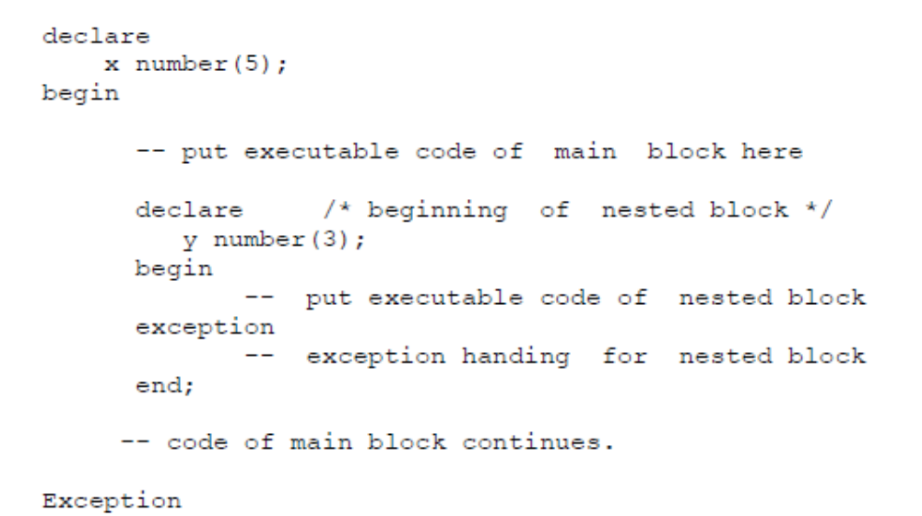
Nesting Blocks
It is possible to define a block within another block. When blocks are defined one within another they are said to be nested.
Prepared by: Mr. A. R. Pradnyavant

Slide 20
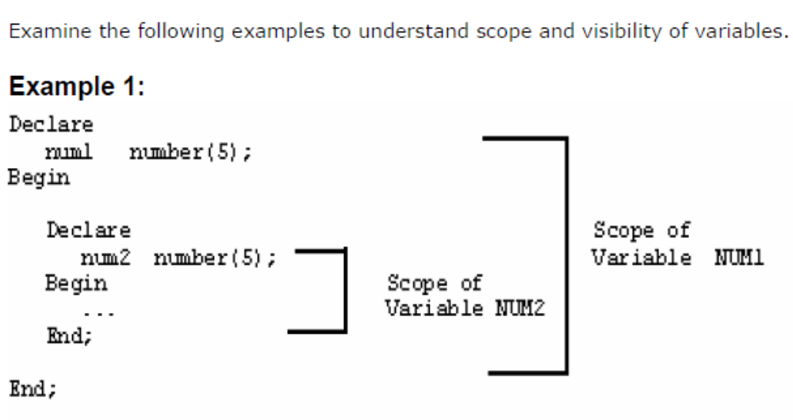
Prepared by: Mr. A. R. Pradnyavant

Slide 21
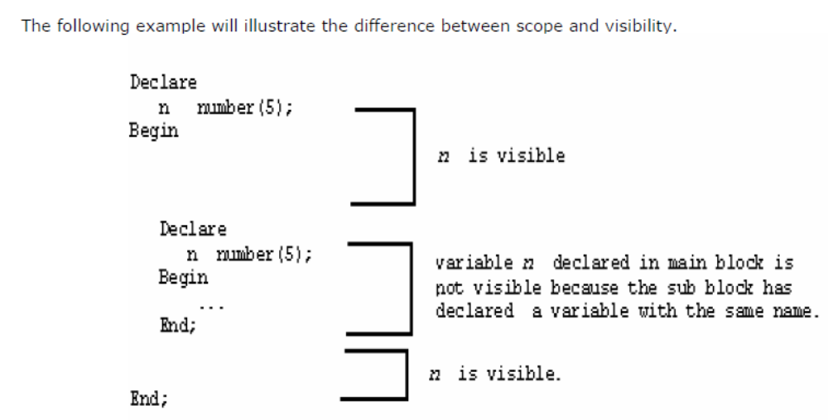
Prepared by: Mr. A. R. Pradnyavant

Slide 22
What is a stored procedure?
A stored procedure is a PL/SQL block that is stored in the database with a name.
Each procedure is meant for a specific purpose.
A stored procedure is stored in the database as an object. It is also called as database procedure as it is stored in the database.
A procedure may take one or more parameters.
If a procedure takes parameters then these parameters are to be supplied at the time of calling the procedure.
Prepared by: Mr. A. R. Pradnyavant

Slide 23
Procedural SQL (PL/SQL) is a language that makes it possible to use and store procedural code and SQL statements within the database and to merge SQL and traditional programming constructs, such as variables, conditional processing (IF-THEN-ELSE), basic loops (FOR and WHILE loops,) and error trapping.
Prepared by: Mr. A. R. Pradnyavant

Slide 24
Advantages of stored procedures
Reduced network traffic
Better Performance
Easy Maintenance
Security
Owner rights
Invoker rights
Prepared by: Mr. A. R. Pradnyavant

Slide 25
What is a function?
A function is similar to procedure, except that it returns a value. The calling program should use the value returned by the function.
Prepared by: Mr. A. R. Pradnyavant

Slide 26
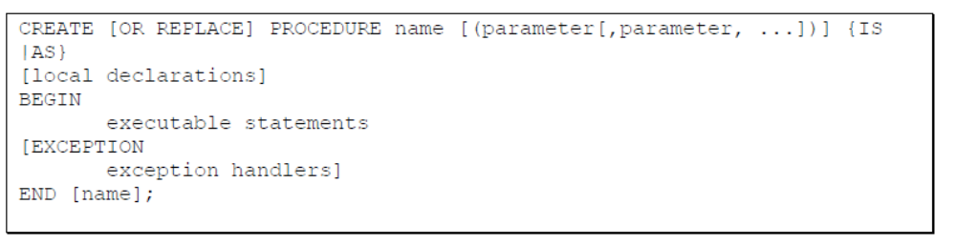
Creating a stored procedures
A stored procedure is created using CREATE PROCEDURE command.
Prepared by: Mr. A. R. Pradnyavant

Slide 27
OR REPLACE is used to create a function even though a function with the same name already exists
RETURN datatype specifies the type of data to be returned by the function.
RETURN statement in the executable part returns the value. The value must be of the same type as the return type specified using RETURN option in the header.
Prepared by: Mr. A. R. Pradnyavant

Slide 28
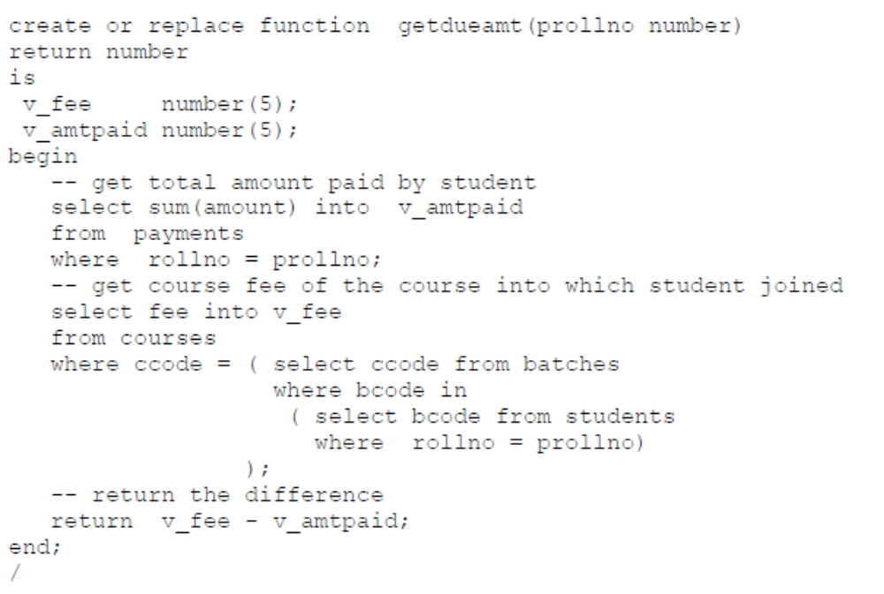
The following stored function takes roll number of the student and return the amount yet to be paid by the student.
Prepared by: Mr. A. R. Pradnyavant

Slide 29
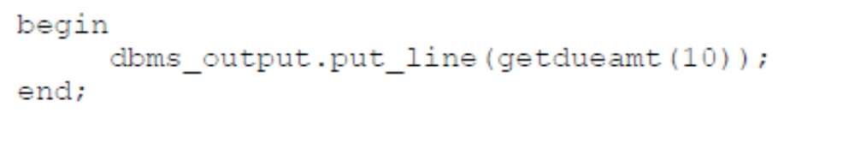
The above function can be called from a PL/SQL block as follows:
User-defined PL/SQL functions can be used in SQL in the same manner as the standard functions such as ROUND and SUBSTR..
Prepared by: Mr. A. R. Pradnyavant

Slide 30
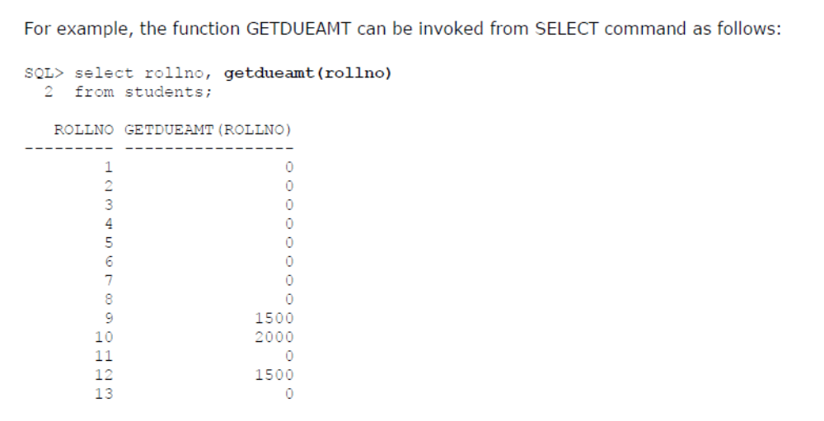
Prepared by: Mr. A. R. Pradnyavant

Slide 31
Types of Parameters
Parameters of a procedure are of two types.
Formal parameters
Actual Parameters
Formal Parameters: The parameters declared in the definition of procedure are called as formal parameters.
They receive the values sent while calling the procedure.
procedure increase_fee (pccode varchar2, pamt number)
In the above procedure, PCCODE, PAMT parameters are called as formal parameters.
Prepared by: Mr. A. R. Pradnyavant

Slide 32
Actual Parameters
The values given within parentheses while calling the procedure are called as actual parameters.
increase_feepaid ( v_ccode, 2000);
v_ccode and 2000 are actual parameters. These values are copied to the corresponding formal parameters - pccode and pamt.
Prepared by: Mr. A. R. Pradnyavant

Slide 33
Parameter Modes
Parameter mode is used to specify what can be done with formal parameter. The following are the available modes.
_x0001_ IN
_x0001_ OUT
_x0001_ IN OUT
Prepared by: Mr. A. R. Pradnyavant

Slide 34
IN mode
IN parameters lets you pass a value to the subprogram being called. The value cannot be changed inside the subprogram.
It is like a constant in the subprogram. Therefore it cannot be assigned a value.
procedure increase_fee (pccode in varchar2, pamt number) is
begin
. . .
end;
The actual parameter corresponding to IN parameter can be a variable, constant, or expression.
The default parameter mode is IN. In the above example though we didn’t specify the parameter mode for PAMT is it taken as IN parameter.
Prepared by: Mr. A. R. Pradnyavant

Slide 35
OUT Mode
An OUT parameter lets the subprogram pass a value to caller. Inside the subprogram OUT parameter is an uninitialized variable.
Subprogram has to place a value in the OUT parameters, which will be used by caller program.
Whatever changes are made to formal parameter, the changes will be made available to actual parameter.
Prepared by: Mr. A. R. Pradnyavant

Slide 36
IN OUT Mode
It is same as IN and OUT modes put together.
It can get a value from the calling program and return value to calling program.
The value of this type of parameter can be used in the subprogram and
The actual parameter corresponding to IN OUT parameter must be a variable.
Prepared by: Mr. A. R. Pradnyavant

Slide 37
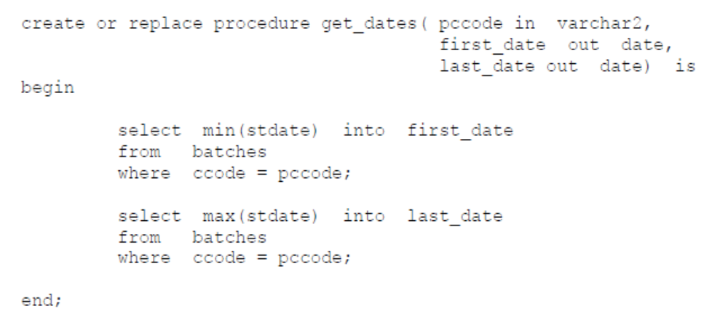
The following procedure takes course code and returns the dates on which the first and last batches of that course have started.
Prepared by: Mr. A. R. Pradnyavant

Slide 38
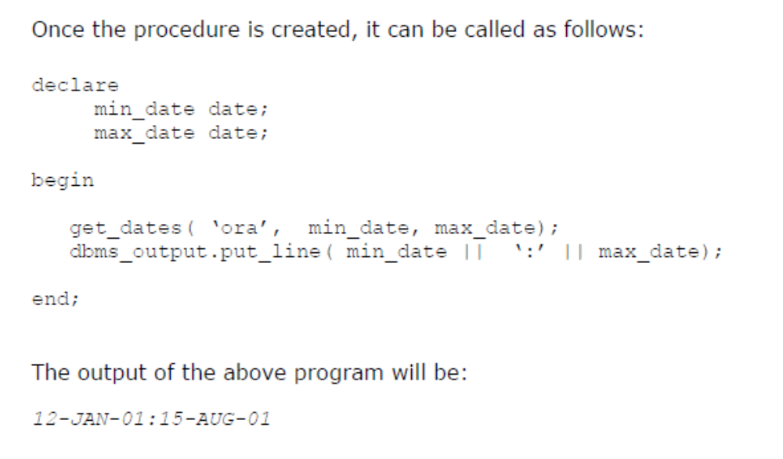
Prepared by: Mr. A. R. Pradnyavant

Slide 39
Triggers
Automating business procedures and automatically maintaining data integrity and consistency are critical in a modern business environment.
One of the most critical business procedures is proper inventory management.
Prepared by: Mr. A. R. Pradnyavant

Slide 40
For example, you want to make sure that current product sales can be supported with sufficient product availability.
Therefore, it is necessary to ensure that a product order be written to a vendor when that product’s inventory drops below its minimum allowable quantity on hand.
Better yet, how about ensuring that the task is completed automatically?
Prepared by: Mr. A. R. Pradnyavant

Slide 41
To accomplish automatic product ordering, you first must make sure the product’s quantity on hand reflects an up-to-date and consistent value. After the appropriate product availability requirements have been set, two key issues must be addressed:
1. Business logic requires an update of the product quantity on hand each time there is a sale of that product.
2. If the product’s quantity on hand falls below its minimum allowable inventory (quantity-on-hand) level, the product must be reordered.
Prepared by: Mr. A. R. Pradnyavant

Slide 42
A trigger is procedural SQL code that is automatically invoked by the RDBMS upon the occurrence of a given data manipulation event. It is useful to remember that:
A trigger is invoked before or after a data row is inserted, updated, or deleted.
A trigger is associated with a database table.
Each database table may have one or more triggers.
Prepared by: Mr. A. R. Pradnyavant

Slide 43
A trigger is executed as part of the transaction that triggered it.
Triggers are critical to proper database operation and management. For example:
Triggers can be used to enforce constraints that cannot be enforced at the DBMS design and implementation levels.
Triggers add functionality by automating critical actions and providing appropriate warnings and suggestions for remedial action.
Prepared by: Mr. A. R. Pradnyavant

Slide 44
In fact, one of the most common uses for triggers is to facilitate the enforcement of referential integrity.
Triggers can be used to update table values, insert records in tables, and call other stored procedures.
Prepared by: Mr. A. R. Pradnyavant

Slide 45
Triggers play a critical role in making the database truly useful; they also add processing power to the RDBMS and to the database system as a whole. Oracle recommends triggers for:
Auditing purposes (creating audit logs).
Automatic generation of derived column values.
Enforcement of business or security constraints.
Creation of replica tables for backup purposes.
Prepared by: Mr. A. R. Pradnyavant

Slide 46
To see how a trigger is created and used, let’s examine a simple inventory management problem.
For example, if a product’s quantity on hand is updated when the product is sold, the system should automatically check whether the quantity on hand falls below its minimum allowable quantity.
Prepared by: Mr. A. R. Pradnyavant

Slide 47
To demonstrate that process, let’s use the PRODUCT table in Figure 8.30. Note the use of the minimum order quantity (P_MIN_ORDER) and the product reorder flag (P_REORDER) columns. The P_MIN_ORDER indicates the minimum quantity for restocking an order. The P_REORDER column is a numeric field that indicates whether the product needs to be reordered (1 = Yes, 0 = No). The initial P_REORDER values will be set to 0 (No) to serve as the basis for the initial trigger development.
Prepared by: Mr. A. R. Pradnyavant

Slide 48
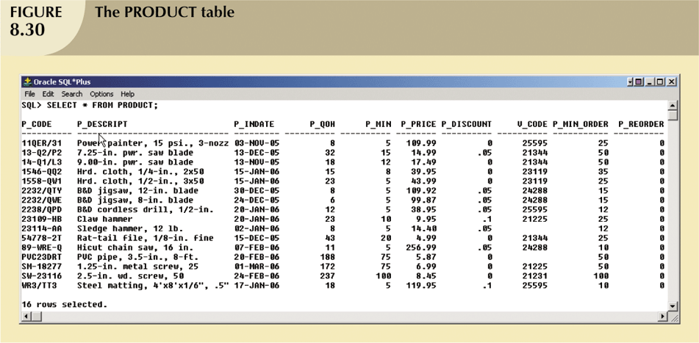
Triggers
Prepared by: Mr. A. R. Pradnyavant

Slide 49
Given the PRODUCT table listing shown in Figure 8.30, let’s create a trigger to evaluate the product’s quantity on hand, P_QOH. If the quantity on hand is below the minimum quantity shown in P_MIN, the trigger will set the P_REORDER column to 1. (Remember that the number 1 in the P_REORDER column represents “Yes.”)
Prepared by: Mr. A. R. Pradnyavant

Slide 50
The syntax to create a trigger in Oracle is:
CREATE OR REPLACE TRIGGER trigger_name
[BEFORE / AFTER] [DELETE / INSERT / UPDATE OF column_name] ON table_name [FOR EACH ROW]
[DECLARE] [variable_namedatatype[:=initial_value] ]
BEGIN
PL/SQL instructions; ..........
END;
Prepared by: Mr. A. R. Pradnyavant

Slide 51
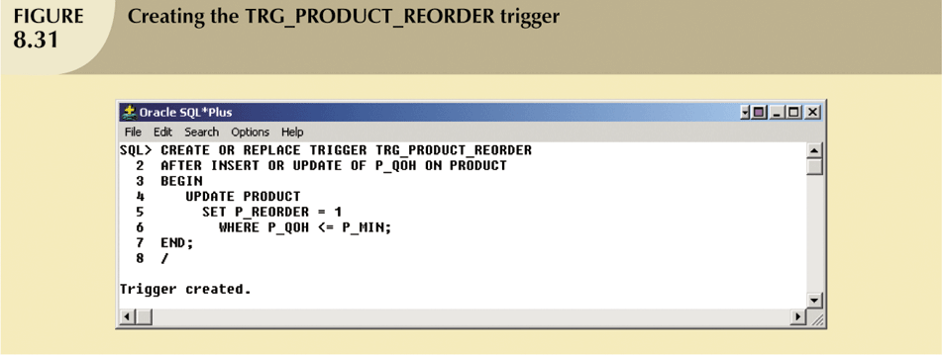
Triggers (continued)
Prepared by: Mr. A. R. Pradnyavant

Slide 52
To test the TRG_PRODUCT_REORDER trigger, let’s update the quantity on hand of product ‘11QER/31’ to 4.
After the UPDATE completes, the trigger is automatically fired and the UPDATE statement (inside the trigger code) sets the P_REORDER to 1 for all products that are below the minimum. (See Figure 8.32.)
Prepared by: Mr. A. R. Pradnyavant

Slide 53
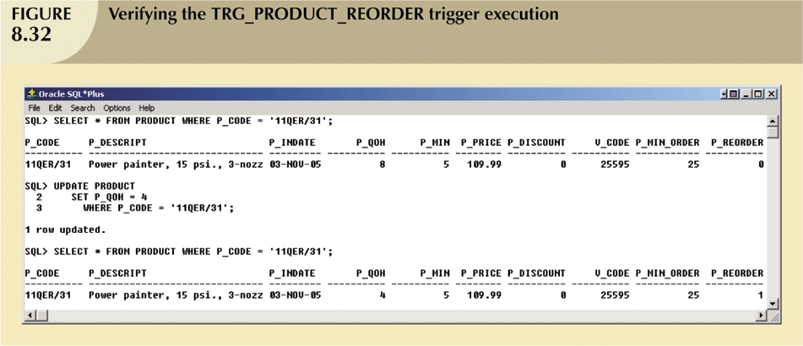
Triggers (continued)
Prepared by: Mr. A. R. Pradnyavant

Slide 54
The trigger shown in Figure 8.32 seems to work fine, but what happens if you reduce the minimum quantity of product ‘2232/QWE’? Figure 8.33 shows that when you update the minimum quantity, the quantity on hand of the product ‘2232/QWE’ falls below the new minimum, but the reorder flag is still 0. Why?
Prepared by: Mr. A. R. Pradnyavant

Slide 55
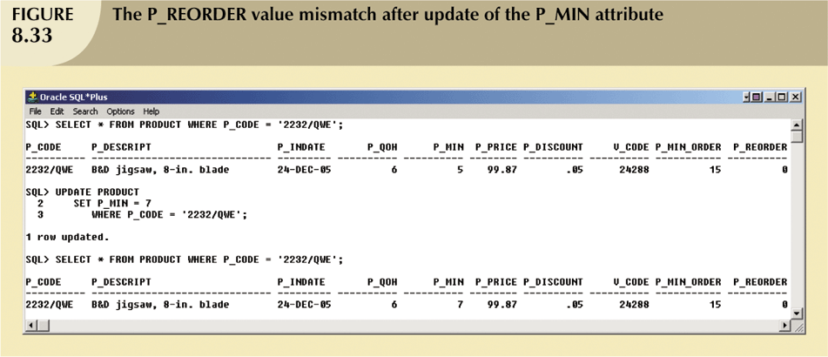
Triggers (continued)
Prepared by: Mr. A. R. Pradnyavant

Slide 56
The answer is simple: you updated the P_MIN column, but the trigger is never executed. TRG_PRODUCT_ REORDER executes only after an update of the P_QOH column! To avoid that inconsistency, you must modify the trigger event to execute after an update of the P_MIN field, too. The updated trigger code is shown in Figure 8.34.
Prepared by: Mr. A. R. Pradnyavant

Slide 57
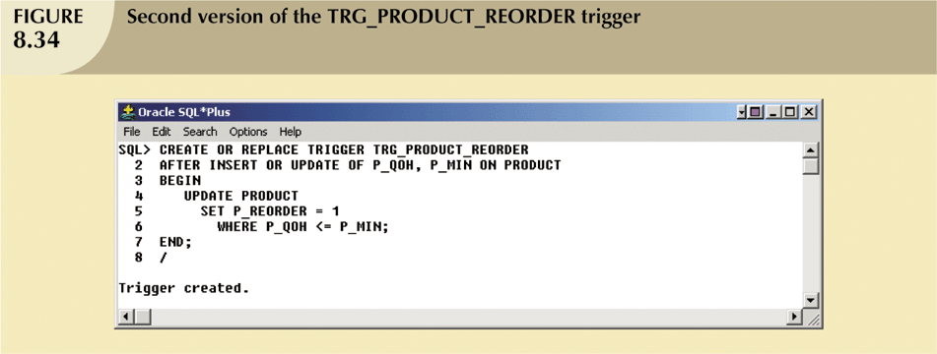
Triggers (continued)
Prepared by: Mr. A. R. Pradnyavant

Slide 58
To test this new trigger version, let’s change the minimum quantity for product ‘23114-AA’ to 10. After that update, the trigger makes sure that the reorder flag is properly set for all of the products in the PRODUCT table. (See Figure 8.35.)
Prepared by: Mr. A. R. Pradnyavant

Slide 59
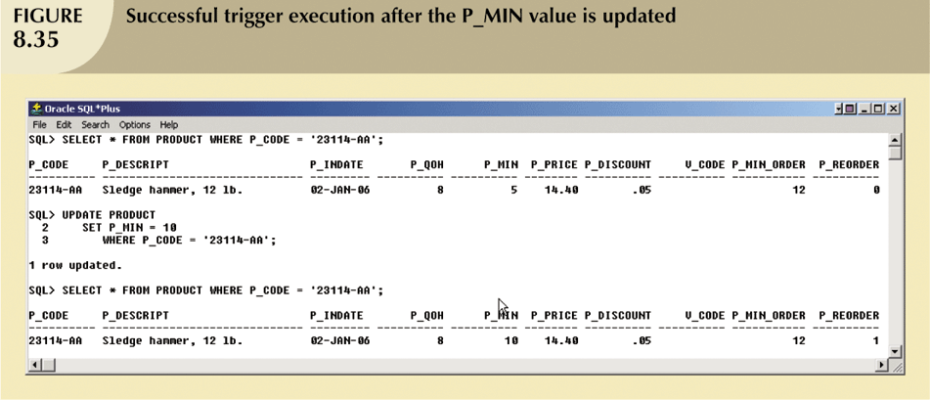
Triggers (continued)
Prepared by: Mr. A. R. Pradnyavant

Slide 60
Packages
Packages are schema objects that groups logically related PL/SQL types, variables, and subprograms.
A package will have two mandatory parts −
Package specification
Package body or definition
Prepared by: Mr. A. R. Pradnyavant

Slide 61
Package Specification
The specification is the interface to the package. It just DECLARES the types, variables, constants, exceptions, cursors, and subprograms that can be referenced from outside the package.
All objects placed in the specification are called public objects.
Any subprogram not in the package specification but coded in the package body is called a private object.
CREATE PACKAGE cust_sal AS
PROCEDURE find_sal(c_id customers.id%type);
END cust_sal;
/
When the above code is executed at the SQL prompt, it produces the following result −
Package created.
Prepared by: Mr. A. R. Pradnyavant

Slide 62
Package Body
The package body has the codes for various methods declared in the package specification and other private declarations, which are hidden from the code outside the package.
The CREATE PACKAGE BODY Statement is used for creating the package body.
The following code shows the package body declaration for the cust_sal package created.
I assumed that we already have CUSTOMERS table created in our database as mentioned in the PL/SQL
Prepared by: Mr. A. R. Pradnyavant

Slide 63
Package Body
CREATE OR REPLACE PACKAGE BODY cust_sal AS
PROCEDURE find_sal(c_id customers.id%TYPE) IS
c_sal customers.salary%TYPE;
BEGIN
SELECT salary INTO c_sal
FROM customers
WHERE id = c_id;
dbms_output.put_line('Salary: '|| c_sal);
END find_sal;
END cust_sal;
/
When the above code is executed at the SQL prompt, it produces the following result −
Package body created.
Prepared by: Mr. A. R. Pradnyavant

Slide 64
Using the Package Elements
The package elements (variables, procedures or functions) are accessed with the following syntax −
package_name.element_name;
Consider, we already have created the above package in our database schema, the following program uses the find_sal method of the cust_sal package −
DECLARE
code customers.id%type := &cc_id;
BEGIN
cust_sal.find_sal(code);
END;
/
Enter value for cc_id: 1
Salary: 3000
PL/SQL procedure successfully completed.
Prepared by: Mr. A. R. Pradnyavant

Slide 65
Package Body
The following program provides a more complete package. We will use the CUSTOMERS table stored in our database with the following records −
Select * from customers;
+----+----------+--------+----------------+-----------------+
| ID | NAME | AGE | ADDRESS | SALARY |
+----+----------+---------+----------------+----------------+
| 1 | Ramesh | 32 | Ahmedabad | 3000.00 |
| 2 | Khilan | 25 | Delhi | 3000.00 |
| 3 | kaushik | 23 | Kota | 3000.00 |
| 4 | Chaitali | 25 | Mumbai | 7500.00 |
| 5 | Hardik | 27 | Bhopal | 9500.00 |
| 6 | Komal | 22 | MP | 5500.00 |
+----+------------+-------+---------------+-----------------+
Prepared by: Mr. A. R. Pradnyavant

Slide 66
Synonyms
A synonym is an alternative name for objects such as tables, views, sequences, stored procedures, and other database objects.
You generally use synonyms when you are granting access to an object from another schema
Syntax
The syntax to create a synonym in Oracle is:
CREATE [OR REPLACE] [PUBLIC] SYNONYM [schema .] synonym_name
FOR [schema .] object_name [@ dblink];
Prepared by: Mr. A. R. Pradnyavant

Slide 67
Synonyms
OR REPLACE
Allows you to recreate the synonym (if it already exists) without having to issue a DROP synonym command.
PUBLIC
It means that the synonym is a public synonym and is accessible to all users. Remember though that the user must first have the appropriate privileges to the object to use the synonym.
schema
The appropriate schema. If this phrase is omitted, Oracle assumes that you are referring to your own schema.
Prepared by: Mr. A. R. Pradnyavant

Slide 68
Synonyms
object_name
The name of the object for which you are creating the synonym. It can be one of the following:
table
view
sequence
stored procedure
function
package
materialized view
java class schema object
user-defined object
synonym
Prepared by: Mr. A. R. Pradnyavant

Slide 69
Synonyms
For example:
CREATE PUBLIC SYNONYM suppliers
FOR app.suppliers;
This first CREATE SYNONYM example demonstrates how to create a synonym called suppliers. Now, users of other schemas can reference the table called suppliers without having to prefix the table name with the schema named app.
For example:
SELECT *
FROM suppliers;
Prepared by: Mr. A. R. Pradnyavant

Slide 70
Synonyms
If this synonym already existed and you wanted to redefine it, you could always use the OR REPLACE phrase as follows:
CREATE OR REPLACE PUBLIC SYNONYM suppliers
FOR app.suppliers;
Drop synonym
Once a synonym has been created in Oracle, you might at some point need to drop the synonym.
Syntax
The syntax to drop a synonym in Oracle is:
DROP [PUBLIC] SYNONYM [schema .] synonym_name [force];
Prepared by: Mr. A. R. Pradnyavant

Slide 71
Synonyms
PUBLIC
Allows you to drop a public synonym. If you have specified PUBLIC, then you don't specify a schema.
force
It will force Oracle to drop the synonym even if it has dependencies. It is probably not a good idea to use force as it can cause invalidation of Oracle objects.
Example
Let's look at an example of how to drop a synonym in Oracle.
For example:
DROP PUBLIC SYNONYM suppliers;
This DROP statement would drop the synonym called suppliers that we defined earlier.
Prepared by: Mr. A. R. Pradnyavant

